Slide 1
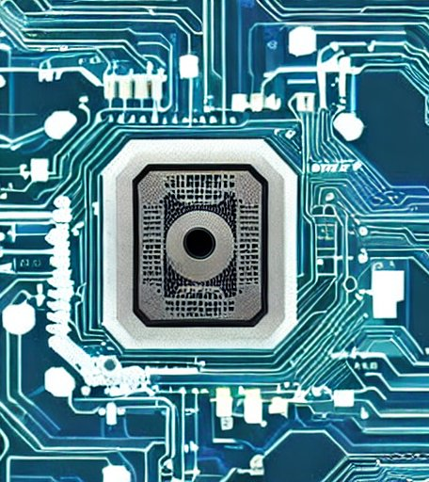
Hardware Specialization for AI/ML
A Systematization of Knowledge study on
Alenkruth Krishnan Murali (jht9sy)
Khyati Kiyawat (vyn9mp)
Sabiha Tajdari (jvx2tt)

Slide 2
Outline
Applications of AI/ML
Basics of AI/ML
Types of computations required
Need for Specialization
Current Accelerator Space
Data Center AI Accelerators
Edge AI Accelerators
Past, Present and Future
References

Slide 3
Applications of ML and AI
NLP - Speech and Text (Voice assistants)
Image recognition - Computer Vision
Recommendation Systems
Medical Diagnosis
Placement and Routing (floorplanning)
Code completion
Attack detection and generation
Accelerator design?

Slide 4
Basic CNN example
DaDianNao: A Machine-Learning Supercomputer[2015], Chen Y et al.
Notes:
Let’s take a very basic CNN example (CNN stands for convolutional neural network). This model is doing some sort of object detection.
Using convolution, it extracts the feature, then normalize them (removing the redundant or insignificant values, then there is pooling layer which basically reduces the size of features by talking maximum or average of some cells. Then, comes the classifier which detects the object.
Similar to this example, there can be many convolutional layers, pooling layers, fully connected layers, etc. Let’s what happens computationally in these layers.. Convolution is multiply and accumulate, Pooling – basic addition to comparator, classifier has an activation but input to the w*i that is multiplication.

Slide 5
Typical computations for AI/ML
Requires MAC operation for
feature extraction and classification
both of which are highly parallelizable
Table along side shows types of instructions and operations required for AI accelerators [1].
These operations are not computationally complex but data intensive
1. AI Accelerator on IBM Telum Processor [2022], Lichtenau et el.
Notes:
Let’s now dive down into little bit of history of processors.

Slide 6
Need for HW specialization
History of processors
Leveraging the advancements in technology nodes (Moore’s law)
Single core
Thermal issues, stopped gaining from single cores
Super-scalar and Multi-core processor
Dark Silicon issue
Heterogenous processing to exploit performance based on workloads
For optimum resource utilization and best performance
Need to design architectures based on workloads
Complex general purpose computation is not always the solution –
Image and Video processing – GPUs
For scientific calculation with complex mathematical function, that are not supported by basic ALUs – we need co-processors like FPU (floating point unit), TMU – Trigonometric mathematical unit, etc.
Sorting, genomics – need for circuits that are proficient in sequencing: Ex. automata processors
ML/AI – MAC operations, highly parallel computation, reduce data movement

Slide 7
Memory wall
Processor performance scales as technology scales, but the latency of DRAM access scales very slowly[2]
Why? DRAMs are traditionally designed for high transistor density, whereas compute units are designed for high performance
Paves way to research on - when, where and how to compute - improving memory bandwidth
thinking of new memory technologies
Neuromorphic circuits, SNN, PiM
Data movement from DRAM is the most energy expensive operation[1]
1. Hardware for Machine Learning: Challenges and Opportunities[2017], Sze et el. 2. Computing's energy problem (and what we can do about it)[2014], Mark H.
Notes:
And ML/AI operations are typically characterized with lot of data movement – memory reads, write for input, weights, and output.
Plausible solutions : Processing in Memory, Spiking NN, Neuromorphic circuits that compute using analog signals
From the Computing Energy problem:
Processor performance scale with technology scale but the latency of DRAM access scales very slowly.
So, one potential solution can be to increase the size of the cache and reduce miss rates
But cache has high leakage energy, and the evolving data size , how do increase the cache size, and we don’t how leakage energy increases with increase in cache size or scaling in technologu
Why is dram access slow - because it is off-chip
DRAM/memories are highly specialized for high transistor density, where other cpu components are designed for fast performance

Slide 8
What is memristor
Memristor is a hardware that can perform matrix multiplication with high speed
By setting the voltage to the value of Ni and having the matrix W, the product of the matrix can be obtained by having the resistance Ri and reading the current
Matrix multiplication is calculated in parallel => efficiency increase
High Power Consumption

Slide 9
How to Improve memristor Power
Quantization
=> To reduce data bits and fractions
Pruning
=> To reduce number of weights in learning
Data loss
Accuracy
Solve This Problem Using ADMM
min F( {w_{i}}^{N}_{i=1} , {b_{i}}^{N}_{i=1}) , W_{i} ꞓ P_{i} , b_{i} ꞓ Q_{i}
{w_{i}},{w_{i}}
=> Find the Optimum Conductance State Levels
=> Remove Unnecessary Coefficients
Accuracy
Fast and Parallel Computing
Power Usage

Slide 10
Current Accelerator Space
Figure from AI and ML Accelerator Survey and Trends [2022], Reuther et el.

Slide 11
Data Center AI Accelerators
Requirements
Train? Infer?
The accelerators
ASIC
FPGA
CGRA?
PIM
GPU
Our observations
Figure from AI and ML Accelerator Survey and Trends [2022], Reuther et el.
Notes:
Disclaimer about AI knowledge and completeness of the survey (your favorite accelerator might not be here)
Mention about citation
Summarize how they meet requirements in the observations section

Slide 12
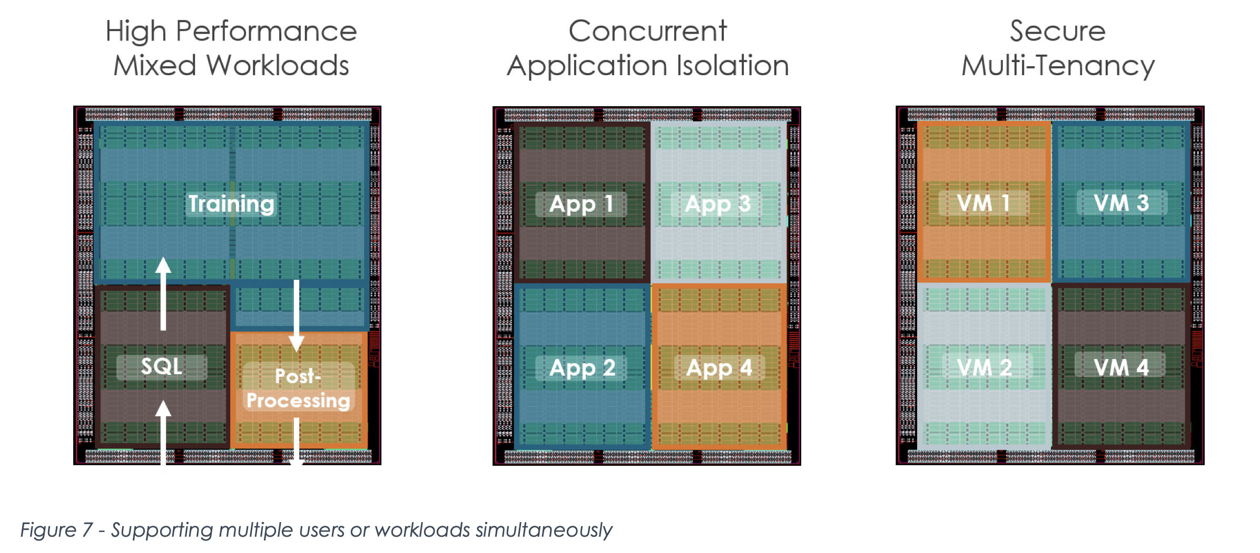
Requirements for Data Center AI Acceleration
Latency (Service Level Objectives/Agreements[SLO/SLA])
Total Cost of Ownership (TCO)
Target select algorithms vs Target wide algorithm base
Multi-tenancy and Isolation (sometimes, mixed workloads)
Scalability and Future Proofing
Power consumption and Cooling
Programmability
Accelerated Computing with a Reconfigurable Dataflow Architecture[2021], SambaNova Systems.
Notes:
1. for the tail latency, the accelerators for inference had a hard limit on the p99 latency.
2. The total cost of ownership is the Capital Expense + Operating costs. Everything is a business, and companies care about where they spend their money and what they gain.
3.
4. multi tenancy is necessary for all inference accelerators. Isolation and privacy.. Even mixed workloads for some accelerators!
5. Can the current accelerator accelerate the future models?? DL models scale by 1.5x yearly
6. We have ample room for efficient designs and we are not strictly constrained by power. Lower power means easier cooling, which the datacenters love.
7. Ease of programmability. Taking the hardware to the level of the DL engineers.

Slide 13
Train? Infer?
TRAINING
INFERENCE
Frequent memory updates (forward and back propagation)
Large models and parallelization constraints – distributed training is limited by off-chip bandwidth
Wider operands
Training is experimentation
Compute intensive
Weights are only read once
Parallelization is easier
High precision is not a "need"
Inference is a one-time activity
Not as intensive as training

Slide 14
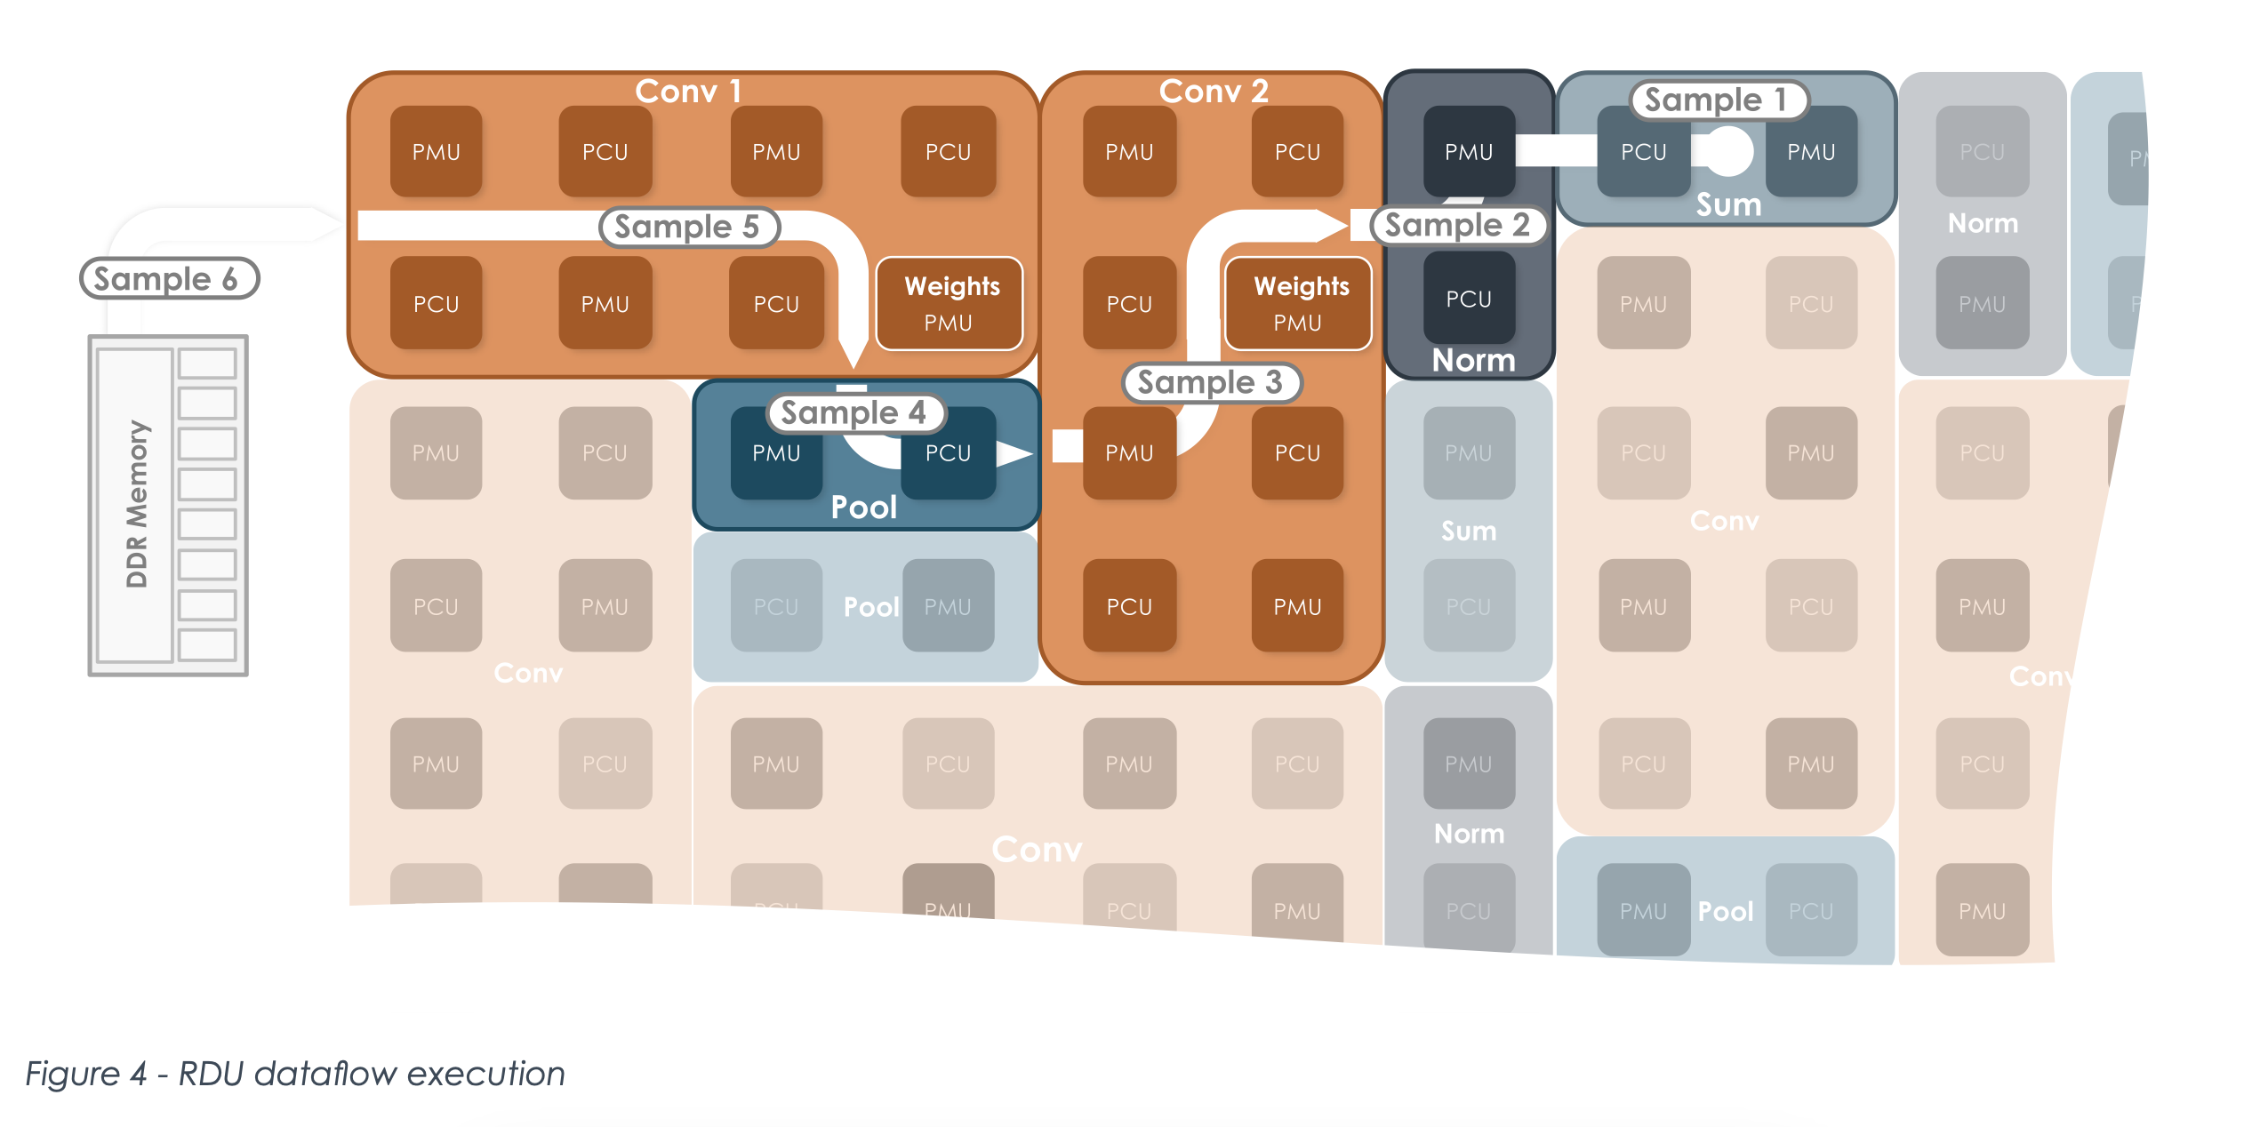
Some Common Strategies
High Bandwidth and High Capacity Memories to store weights
Matrix multiply and Vector operation units
Systolic arrays and (explicit) dataflow architectures
Large on-chip memories (weight pinning)
Data types of varied precision (tailored for AI)
FP32, TF32, BF16, FP16, DLFLT16, UINT8, INT8 and maybe INT4
Size of datatype influences power
SIMD execution, MIMD execution, SIMT execution!
Accelerated Computing with a Reconfigurable Dataflow Architecture[2021], SambaNova Systems.

Slide 15
Hardware and Software for AI/ML?
Safe to assume all the following works have a similar software stack.
Accelerated Computing with a Reconfigurable Dataflow Architecture[2021], SambaNova Systems.
Notes:
We started this exploration to learn about how hardware is designed for AI. But we discovered it was Software and Hardware for AI/ML. Software does the heavy lifting in most cases.

Slide 16
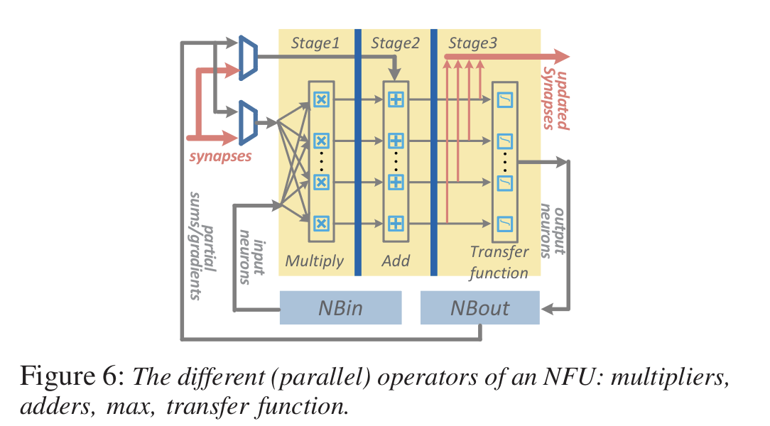
DaDianNao - ASIC Accelerator
Training and Inference
Tile based accelerator (recurring design choice)
Uses Embedded DRAM (eDRAM) instead of SRAMs for density
Weights are pinned to the eDRAM - limits off-chip memory access.
More space to memory rather than compute
Memory is split between tiles for high bandwidth.
More MACs than contemporary GPUs
36MB of eDRAM is insufficient for current ML model training.
DaDianNao: A Machine-Learning Supercomputer [ISCA 2014], Chen et al.
Notes:
Old work from 2014.
Demonstrates the power of better memory bandwidth.
Academic work – no importance to SW, latency, power – 16W per node, no futuristic design.

Slide 17
Google TPU v1 and v4i - ASIC Inference accelerators
Inference only accelerators targeted for MLP, RNN-LSTM and CNN (in v1 - 2015)
Support for BERT, transformer encoder and LSTM decoder, Wave RNN (2020).
TPU v4i details:
128MB common memory allows reuse of weights during inference
Inference in batches
Systolic array Matrix Multiplication - 4x 128x128
XLA compiler compiles the NN models.
322b VLIW ISA
175W TDP - Air cooled
on-chip interconnect
bf16/int8
In-Datacenter Performance Analysis of a Tensor Processing Unit (ISCA 2017), Jouppi et al.
Ten lessons from Three Generations Shaped Google's TPUv4i (ISCA 2021), Jouppi et al.
Notes:
BERT did not exist during v1, appeared in 2018. But in 2020, it was 28% of workload. Need for future proofing.
On-chip memory for alleviating the power and time lost in memory access. Reuse weights.
Batch inference for high resource utilization (parallelism in the model)
Designed for SLO
XLA compiler and VLIW ISA improves programmability – codesign
Air cooling reduces the cost of operation in the Data center – reduced TCO
On and off chip networking for easier scaling with increasing model sizes

Slide 18
Google TPU v2 and v3: ASIC Training Accelerators
v2 and v3 were built around the v1 inference chip.
Larger matrix multiply unit
High Bandwidth Memory with a vector scratch pad memory (SRAM)
Support for bf16 (Matrix Multiplication), fp32 (accumulation)
Activation pipeline is replaced with a more general purpose vector compute unit for training
On and off-chip networking for parallelization at scale. (2 cores per chip)
XLA compiler support. Same VLIW ISA
The Design Process of Google's Training Chips: TPUv2 and TPUv3 [2021], Norrie et al.
Notes:
Training is
1) compute intensive – larger MM unit
2) more data – of different kinds – vectors and higher precision – vector memory coupled with HBM and not DRAM like TPU v1 – accumulator + activation storage = vector memory
3) more programmability -
4) training supercomputer by connecting chips together in the network for training and offloading
They have high TDP and are water cooled. Training is a one time thing and hence this is acceptable for TCO concerns.

Slide 19
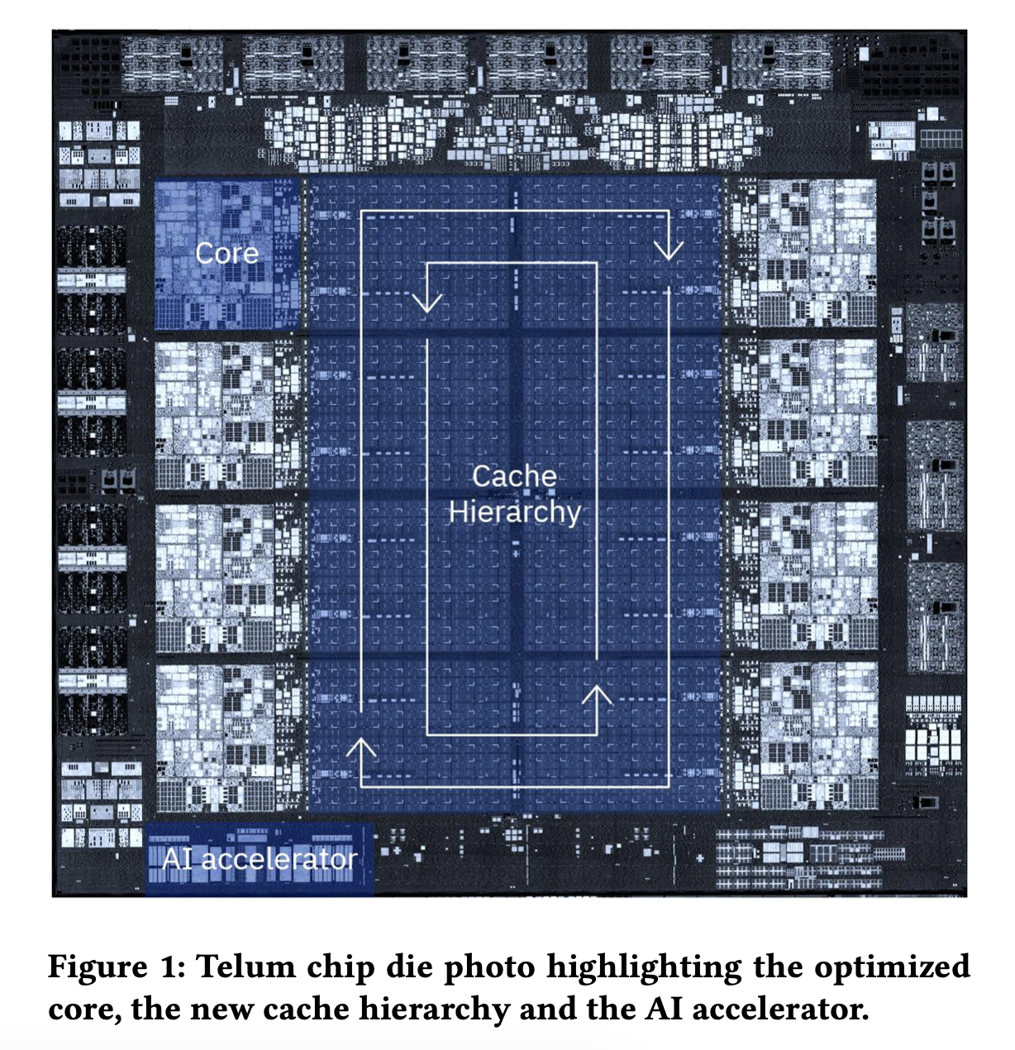
AI Accelerator on IBM Telum - ASIC
On-chip accelerator for inference.
Primarily for privacy and latency concerns
All threads on the multicore can offload
Interfaced shared L2 cache
Coherency is maintained with firmware
Like atomic instructions
Suitable when models are large than L1
Generic accelerator - for multiple models
DLFLT16 support. Big Endian
Firmware updates and Firmware controls offloading
NNPA - Neural Network Processing Assist instructions
No influence on power and clock frequency
Accessed in a per request basis, no chaining.
AI Accelerator on IBM Telum Processor [2022], Lichtenau et el.
Notes:
Meets all requirements from the list, even though the performance is not in par with others.
Accelerates multiple workloads
On-chip since offloading takes time and raises privacy concerns. IBM customers like banks tend to prefer on-chip rather than offloads.
Decision trees and XGBoost models used by customers are not the most cutting edge, since explainability and regulations.
Compute Array
Part 1 - Reduced precision systolic arrays - 128 organized in 8 rows of 16 elements each (actually 8x8 two corelet design) - processor tiles (name)
For Matrix multiplication is DLFLT-16 ( better convergence than FP-16 or brainfloat16)
8way SIMD
Part 2 - Activation Array - 32 - 2 rows of 16 engines
Row 1 - Processing Engines (name) - Area and power efficient SIMD engines - arithmetic, logical, look-up and type conversion
Row 2 - Superset of PE - it can execute DLFLT32 with 4 way SIMD in addition to row 1 stuff - also shifts can be done, data gathering, non-systolic math, data preparation

Slide 20
Tesla Dojo: CPU with AI capabilities - ASIC
Middle ground Between General Purpose CPU and Application Specific ASIC
Uses a custom ISA tuned for ML
Wide SMT Vector and Scalar functional Units
Large SRAM
Built to Scale
NOC Router designed for throughput - relies more on data movement than local storage.
VM, coherency and other poorly scaling features were omitted.
Related:
Tesla had its FSD chip - inference in Autonomous vehicles which is very similar to TPUv1.
DOJO: The microarchitecture of Tesla's Exa-Scale Computer [2022], Talpes et al.
Notes:
Custom ISA for ML workloads
Meets all the requirements and hits it out of the park for scalability, future proofing.

Slide 21
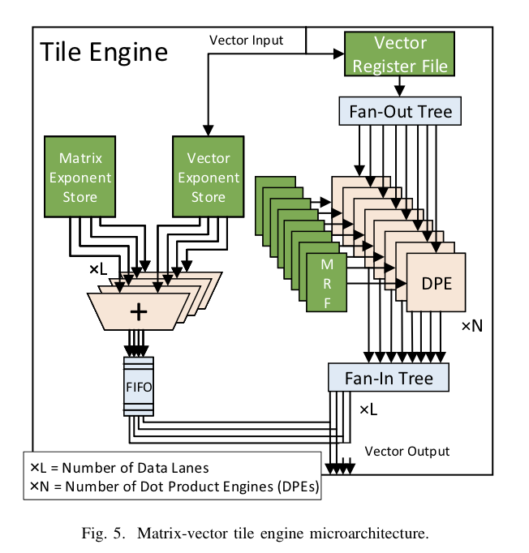
Project Brainwaves - FPGA Inference Accelerator
FPGA based Neural Processing Unit (NPU)
Configurable during compilation
High Flexibility
Batch Size = 1 - Low Latency
DNN accelerator
Single threaded SIMD ISA
Spawns millions of primitive ops
Minimal compiler support needed
Matrix-Vector Multiplication and not Matrix-Matrix
Dataflow architecture (instruction chaining)
Model Pinning
Sub-banked memory (Similar to DaDianNao)
125W on Stratix 10 FPGAs
A Configurable Cloud-ScaleDNN Processor for Real-Time AI [ISCA 2018], Fowers et al.
Notes:
Can vary
Data type precision
Vector size (depends on the model)
Number of Data Lanes
Size of the Matrix vector tile – number of Dot Product Engines

Slide 22
Mipsology with Xilinx FPGAs - FPGA Inference Accelerator
CNN Inference
Software Stack which is aware of underlying FPGA
Accelerates the common layers
Pre-compiled FPGA binaries - optimzed for workload
Zero FPGA knowledge required
Scalable for N FPGA boards
Deep Learning Inferencing with Mipsology using Xililnx ALVEOTM on Dell EMC Infrastructure [2019]

Slide 23
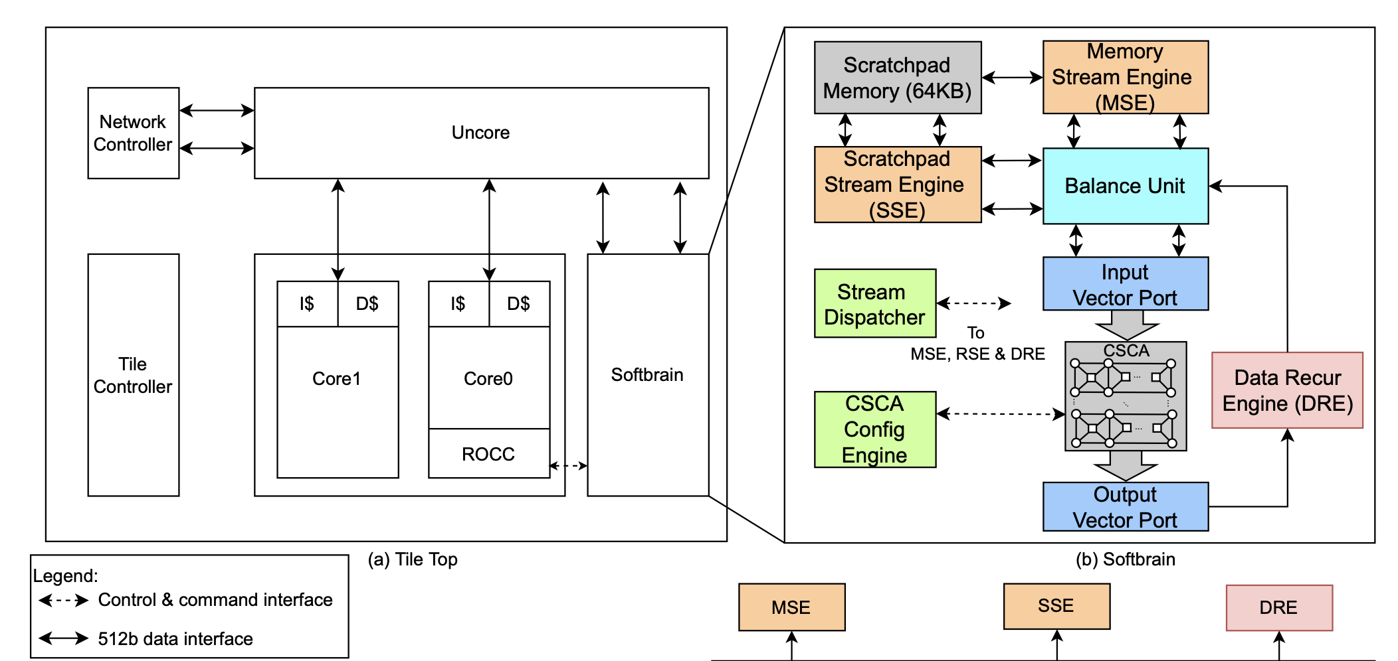
Mozart: Reuse Exposed DataFlow - CGRA
Parallelism in Smaller Batches (N=4) - Accelerate features General to ML and not just DNN/CNN
Reuse Data to maximum extent
Streaming processor - gather and scatter-esque instructions
Configurable Circuit Switch Compute Array (CSCA) - 8 FUs - Dataflow Architecture
Software for configuration of CSCA based on the model.
The Mozart Reuse Exposed Dataflow Processor for AI and Beyond [2022], Sankaralingam et al.
Notes:
Partitioned global address space - helps programmers partition their models effectively
Pod-cast - multicast read stream that facilitates bandwidth-efficient access to the partitioned global address space.
The same vectors are partitioned between tiles
Pre-throw - multicast write stream
Helps avoid redundant fetches and writes
Circuit switched Compute array - similar to CGRA - 8x8 functional units - which is configured during compilation by the compiler

Slide 24
SambaNova: Reconfigurable Dataflow - CGRA
Train and Infer
Accelerate multiple workloads (not just A/ML)
Support pre/post processing of data
ISA tuned for Dataflow architecture
Reconfigurable DataFlow Unit(RDU) with interconnects
PCU - Pattern Compute Unit - SIMD
PMU - Pattern Memory Unit - SRAM
Symbaflow software stack - TensorFlow to RDU
Scalable
Accelerated Computing with a Reconfigurable Dataflow Architecture[2021], SambaNova Systems.
Notes:
Pattern Compute Unit (PCU) — The PCU is designed to execute a single, innermost-parallel operation in an application. The PCU data-path is organized as a multi-stage, reconfigured SIMD pipeline. This design enables each PCU to achieve high- compute density and exploit both loop-level parallelism across lanes and pipeline parallelism across stages.
Pattern Memory Unit (PMU) — PMUs are highly specialized scratchpads that provide on-chip memory capacity and perform a number of specialized intelligent functions. The high PMU capacity and distribution throughout the PCUs minimizes data movement, reduces latency, increases bandwidth and avoids off-chip memory accesses.
Advantages of Dataflow
Less data and code movement reduces memory bandwidth needs and enables the use of much larger, terabyte-sized attached memory for large model support.
Simultaneous processing of an entire graph in a pipelined fashion enables high utilization across a broad range of batch sizes and eliminates the requirement to use large batch sizes to achieve acceptable efficiency.
High on-chip memory capacity and localization, as well as high internal fabric bandwidth enable the ability to run very large models at high performance.
Pipeline processing on RDUs provides predictable, low-latency performance.
Hierarchy of this architecture simplifies compiler mapping and significantly improves execution efficiency.

Slide 25
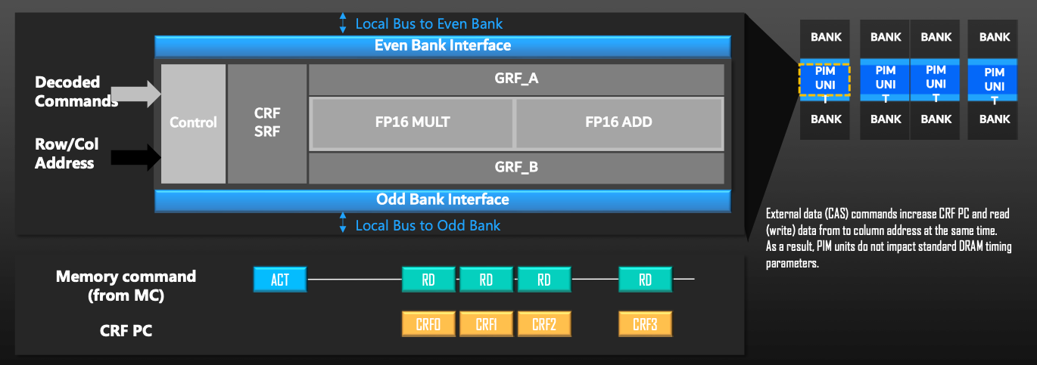
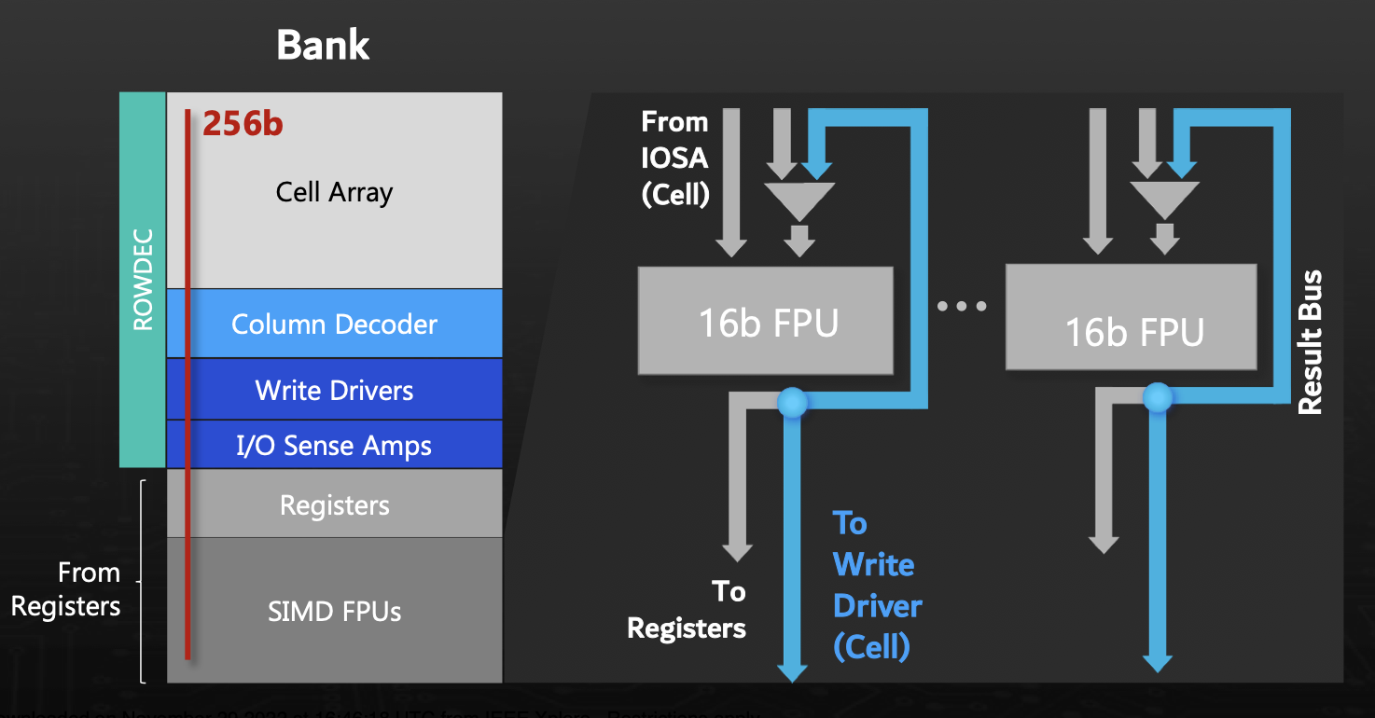
Samsung Aquabolt-XL - HBM2 with PIM
Programmable PIM execution unit at the I/O boundary of a HBM2 bank
Bank-level parallelism: access multi banks/FPUs in a lockstep manner
Same formfactor as non-PIM counterpart - no redesign of DRAM core
SIMD FPUs in the PIM block - Custom RISC 32b ISA
Software stack to exploit new capabilities.
Aquabolt-XL: Samsung HBM2-PIM with in-memory processing for ML accelerators and beyond [2021], Kim et al.

Slide 26
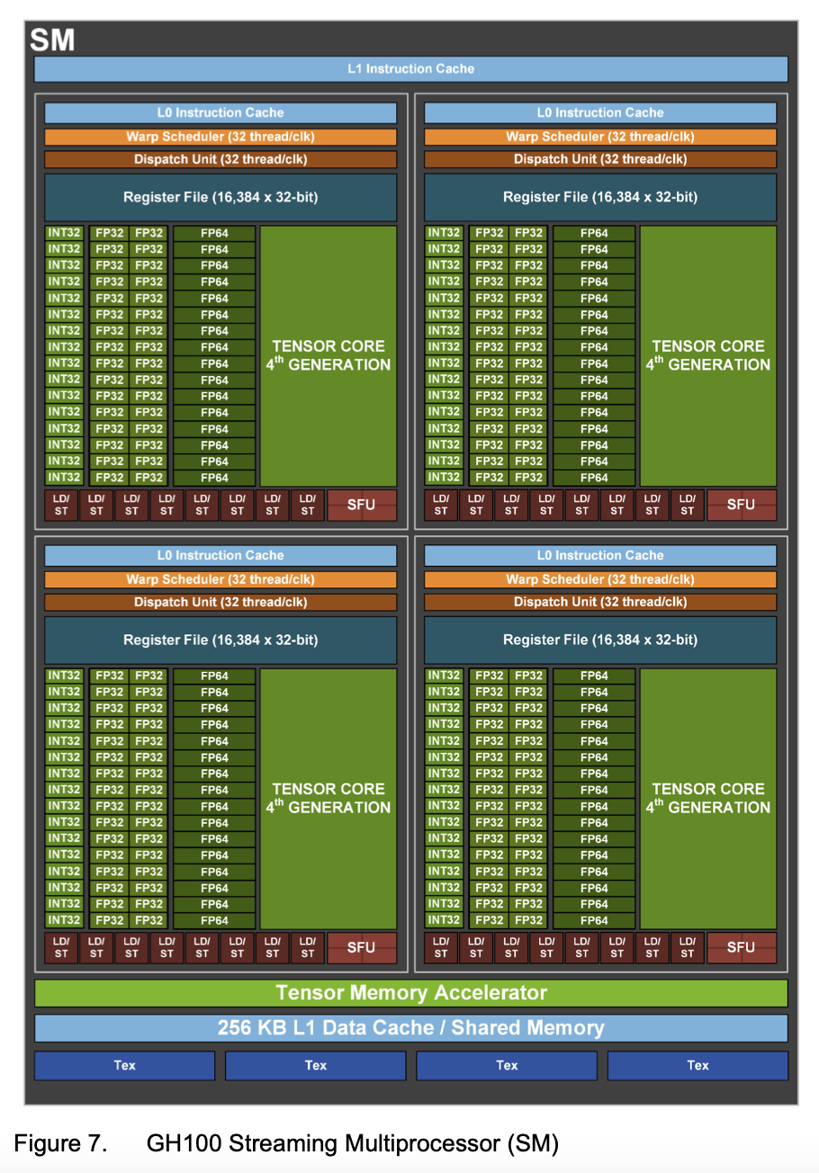
GPU - Graphics Processing Unit
Streaming Multiprocessor (SM)
Dynamic programming Instructions (DPX)
Tensor Memory Accelerator (Data transfer between local and global memory)
Transformer Engine
HBM3 and PCIe 5
NVLink 4 - 900GBps (Multi GPU IO)
NVSwitch - 13.6 Tbits/sec (Between GPUs in clusters, datacenters)
SXM for high power and High Bandwidth (alternate to PCIe)
Clustering of Accelerators a key idea with models scaling.
NVIDIA H100 Tensor Core GPU Architecture [2022], Nvidia.
Notes:
The full implementation of the GH100 GPU includes the following units:
8 GPCs, 72 TPCs (9 TPCs/GPC), 2 SMs/TPC, 144 SMs per full GPU
128 FP32 CUDA Cores per SM, 18432 FP32 CUDA Cores per full GPU
4 fourth-generation Tensor Cores per SM, 576 per full GPU
6 HBM3 or HBM2e stacks, 12 512-bit memory controllers
60 MB L2 cache
Fourth-generation NVLink and PCIe Gen 5

Slide 27
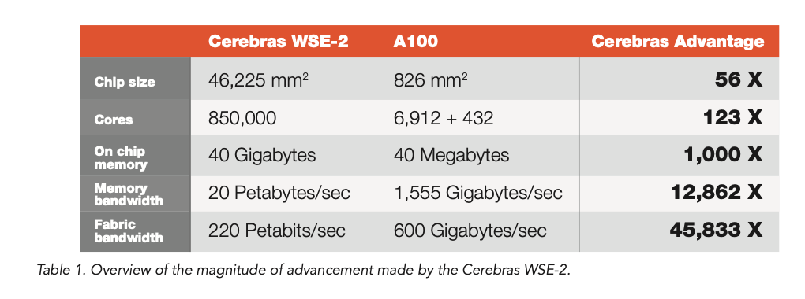
Cerebras Systems: Wafer Scale Engine 2
Use the ENTIRE WAFER!
Interconnects - Swarm
No Multiplying by zero - sparsity aware
Sparse Linear Algebra Compute (SLAC) cores
Cerebras Systems: Achieving Industry Best AI Performance Through A Systems Approach [2021]

Slide 28
Observations
Custom software stack and not just hardware
Exploit parallelism everywhere - Batched inference and distributed training
Generic acceleration (Accelerator Startups)
Abstraction of programming (Accelerator startups)
Resurgence of explicit dataflow architectures.
Large on-chip memories (memory wall is real: PIM solutions)
Value pinning and reconfigurable processing cores/programmable cores
On-chip interconnects and off-chip networks - Scalability with model scaling
Custom data types
Some on-chip accelerators due to customer needs.
Notes:
The design had to adopt strategies to minimize the latency via techniques like batching
3. To specialize or to not specialize has always been a question

Slide 29
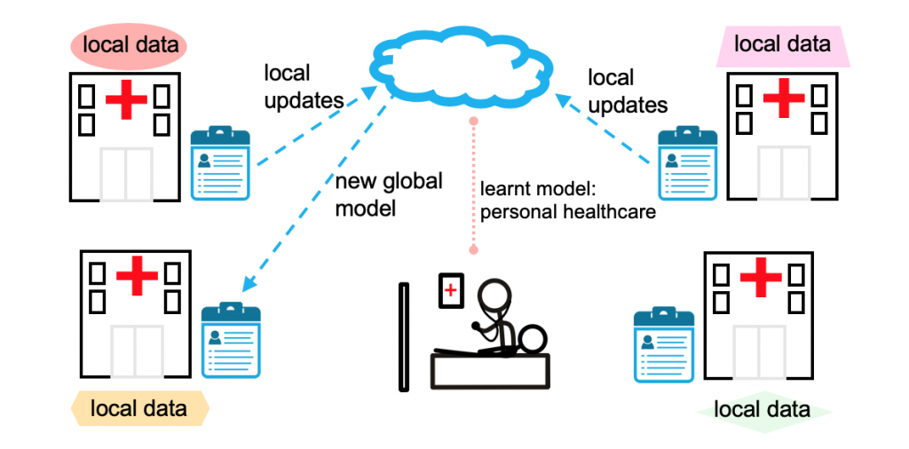
AI/ML accelerators for edge computing
Notes:
Edge computing does not only mean computing on a small device. It can have multiple organization as shown in this figure. I will discuss few works done for the category (AI acclerator design on chip). All other organizations also have challenges related to distributed computing.

Slide 30
Key Metrics for edge/embedded AI/ML accelerators
TOPS/W (Tera Operations per Watt)
Accuracy
Quality of results
Throughput – analytics on high volume data
Latency – autonomous navigation
Hardware cost
Designing and Manufacturing
Flexibility
Due to evolving DNN models
Scalability
Privacy
Hardware for Machine Learning: Challenges and Opportunities[2017], Sze et el.

Slide 31
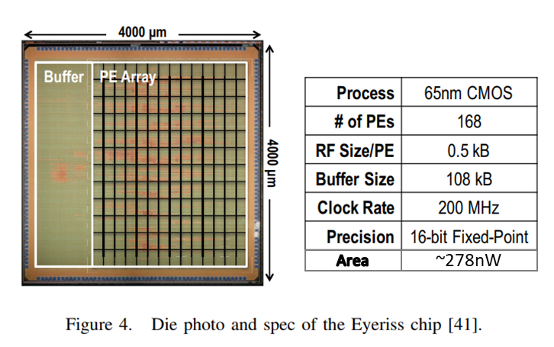
Eyeriss
A very tiny low power AI accelerator chip ~278nW
Is a spatial architecture
Use dataflow processing
To facilitate efficient data reuse
Focused on accelerating DNN
Identified convolution is the most important
Takes 90% - 99% of computation and runtime
Area
Eyeriss: A Spatial Architecture for Energy-Efficient Dataflow for Convolutional Neural Networks[2016], Sze et al.
Notes:
In case of colored image – you have 3 input layers ( for R,G,B)
This is just a 5X5 input and 3X3 filter, real data can be bigger than this
And CNN will have multiple such layers of convolution

Slide 32
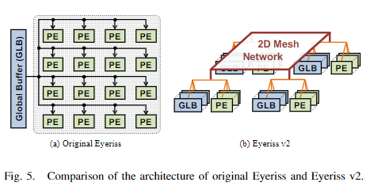
Eyeriss
Eyeriss V2
Dataflow implementation
Output Stationary
Weight Stationary
No Local data reuse
All the input and filter data come from global buffer
All the partial sums and output written to global buffer
Eyeriss proposed novel dataflow implementation
Row-stationary approach
High input reuse (filter, feature maps)
Minimize partial sum accumulation cost
Designed for sparse and compact DNN models
Proposed highly on-chip network, called hierarchy mesh
To adapt to different amount of data-reuse, bandwidth, and utilization
12.6X faster and 2.5X energy efficient than the original Eyeriss
reduce data movement, storage, and computation, reuse as much as possible
Eyeriss v2: A Flexible Accelerator for Emerging Deep Neural Networks on Mobile Devices [2018], Chen Y, et al

Slide 33
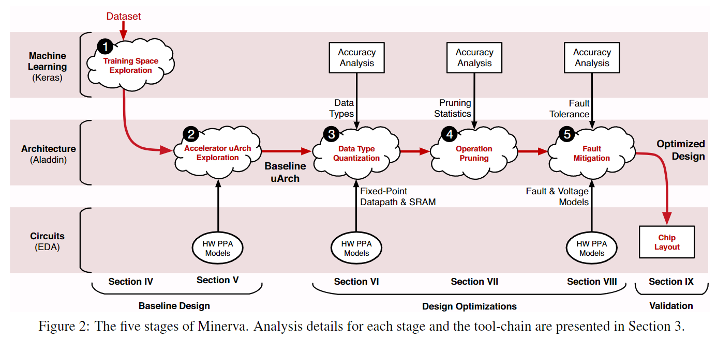
Minerva
Designed to deploy DNNs in power-constrained environment
Automated co-design flow
Power reduction by using
Fine-grained, heterogenous data type optimization
Selective pruning
Lowering SRAM voltage and domain-aware fault mitigation
Approximate to reduce power consumption within the required accuracy limits
Minerva: Enabling Low-Power, Highly-Accurate Deep Neural Network Accelerators[2016], Reagen B. et al.
Notes:
Energy aware pruning – Yang CVPR 2017 – MIT
I have talked about two very important ways to design an AI accelerator for edge. One focused on maximum data-reuse thereby reducing power, and second also tried to apply approximation methods to reduce the overall power consumption.

Slide 34
AI-RISC processor
Introduces AFU: Tightly integrated AI Functional Units
Inspired from history of adding instructions and functional units for commonly used operations
Ex: floating-point arithmetic became popular and eventually we have floating point instructions and units inside the processor
Reduces complexity required to design
bus interfaces
separate ISA for a decoupled AI accelerator
Specialized ISAs are a good option
Such tight integration is good for edge but not for cloud
While data-centers AI accelerators run models with more than 100 billion parameters
tinyML has introduced much smaller models for edge devices i.e. around 100K
AI-RISC: Scalable RISC-V Processor for IoT Edge AI applications[2022], Vaibhav V.
Notes:
Different AI Processing Unit (APU) types and their integration with the CPU hardware stack. (a) Standard loose integration of APU as a co-processor communicating with the CPU over an external bus. (b) Near 3D memory processing solutions embed AI processing functionality into the base logic die of 3D stacked memory. (c) Processing-in-memory solutions convert a part of the memory hierarchy (SRAM, DRAM or NVM) into a dedicated AI Processing Unit (APU). (d) AI-RISC tightly integrates optimum sized accelerators as AI Functional Units (AFU) inside the CPU pipeline (adapted from [1])
And how are these models shrinking: techniques of compression, approximation, pruning, and quantization

Slide 35
AI-RISC Processor (contd.)
Issues with ISA-extension
Compatibility across the stack
Need joint efforts by the community
Agile design infrastructure
Issues with scalability
Future work
Tape-out AI RISC processor
Integrate it with LiteX (open source SoC builder)
End-to-end framework from DSL to GDSII layout

Slide 36
Federated Learning in Edge
Federated learning
Preserve data-privacy
Less data movement
More efficient/less power consumption
Can be implemented using coarse grained reconfigurable array (CGRA) that act like a bunch of mini-accelerators and can be dynamically configured for a particular use case
Prof. David Atienza (EPFL)

Slide 37
Observation
Critical path reduction
Eyeriss identified the most common operation – convolution
Identified the bottleneck -> it’s the data movement, solved it by exploring strategies of data-reuse
Eyeriss V2 discussed about a novel NoC approach to keep the PE’s utilization high
Minerva tried to optimize the MAC operations by compressing the data, pruning the data : remove the operations that don’t impact the results dramatically
Find a way to integrate it with the existing or new framework
AI-RISC is trying to build an end-to-end framework from quick tape-out of AI chips from the Domain specific language description
Notes:
Applying the learnings from the class
-> Eyeriss identified the most common operation – convolution
-> Identified the bottleneck -> it’s the data movement, solved it by exploring strategies of data-reuse
-> Eyeriss V2 discussed about a novel NoC approach to keep the PE’s utilization high
-> Minerva tried to optimize the MAC operations by compressing the data, pruning the data : remove the operations that don’t impact the results dramatically
-> Find a way to integrate it with the existing or new framework
-> AI-RISC is trying to build an end-to-end framework from quick tape-out of AI chips from the Domain specific language description

Slide 38
Major dilemmas
Generalization
Specialization
Bring data to compute
Bring compute to data
Specialized Components
Specialized Instructions
Online learning
Offline learning
Decisions to be made based on trade-offs and workloads
Notes:
The answer is Design Space Exploration

Slide 39
Design Space Exploration
Aladdin
A Pre-RTL, Power-Performance Accelerator Simulator Enabling Large Design Space Exploration of Customized Architecture
For all types of accelerator
Scale-SIM (specially for AI accelerators)
Accelergy – early stage energy estimator
Timeloop – Performance simulator and DNN mapping tool
PIMulator-NN - Simulator designed for PiM based NN accelerators
Once you have designed, how do you integrate, so we also have
Open source RISC-V toolchains
ESP (more flexible than chipyard)
Chipyard, Firesim
One ring that unites and rules them all
Notes:
If you observe most of these accelerators come from academia, they might not as efficient as in-house simulators used in industries. They might face challenges when scaled out.
Design space exploration needs a lot of resources and time… how can we do it on the fly for specialized AI processers.. (overhead of DSE, then overhead of heterogenity in the design, is it worth?)
It’s a question that can be discussed at the end of the presentation
You can't create something that is final, it is evolving.
-- huge research community, nobody will follow one practice
-- Prof Valeria Bertacco, Umich, keynote ISCA 2020
Reinventing the wheel
One ring that unites and rules them all

Slide 40
Past and Present
Cambrian explosion of Accelerators
Novel techniques
Solutions across the stack
Diverse target application and workloads
Limited works on data privacy
Carbon footprint of computing! Large datacenters chugging power.
Reinventing the wheel multiple times
Missing a community effort (industry-academia gap)
Proprietary solutions in the industry
Novel ideas from academia unadopted

Slide 41
Future
Larger models require more data (>540B parameters) - PIM is one solution
Collaboration between within Academia and Industry
Privacy aware ML models and architectures
Homomorphic encryption
Better ML algorithms and newer technologies - Spiking Neural Networks
HW aware Neural Architecture Search (NetAdapt)
Improved process nodes and processing paradigms (eFPGA, low power CGRAs).
Environmental impact of Computing needs to be studied - global warming!
Inference and training at scale
The AI Accelerator Wall?
Are we relying on performance through transistor scaling?
What is the performance boost that we get from intelligent design?

Slide 42
Questions?

Slide 43
Thank you!

Slide 44
Difference between edge and cloud
Main difference between edge and datacenter
Embedded device comes with limited battery capacity
Data centers have a power ceiling due to cooling cost
Cloud cannot support AI functional unit tightly coupled with CPU

Slide 45
Categorizing the accelerators
TPUv2
TPUv3
FL accelerators
TPUv1
TPUv4i
Eyeriss Minerva AI-RISC
SambaNOVA

Slide 47
One solution to make a model work across devices
NetAdapt, that automatically adapts a pre-trained deep neural network to a mobile platform given a resource budget.
https://web.mit.edu/netadapt/
Add this reference for adaptive models

Slide 48
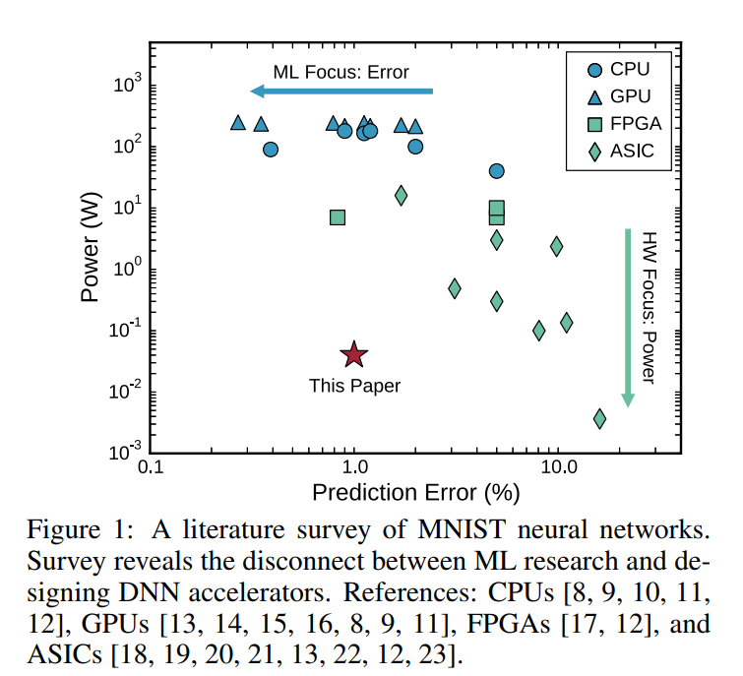
Observation
Need for an end-to-end framework
Minerva: disconnect between ML and Arch research

Slide 49
Need for AI/ML specialized processing
Some graph from survey papers
Energy efficiency for specialized hardware is 2 to 3 orders of magnitude more efficient than a processor-based solution (computing energy paper)

Slide 50
2014 = 1 -10 billion parameters (DNN,CNN)
If 1 parameter is 64 bits
= 8GB
2022 = 540 billion parameters
=4320 GB ~ 4 TB
2032 ~ 10s of trillion of parameters ~ 24 TB…
Only talk about parameters, -- memory size can depend on the model precision. (1bit- 64 bits)
https://ai.googleblog.com/2022/04/pathways-language-model-palm-scaling-to.html

Slide 51
Types of Accelerators
Based on Processing
Temporal v/s Spatial
Based on technology
Neuromorphic
PIM
Training vs inference
Training - TPU 2, 3 and 4| GPUs
Inference - TPU 1 and TPU v4i
ISA extensions
GPU, TPU, AI –RISC
Data type
Notes:
There are various emerging technologies that can exploit the massive data parallelism and minimal compute. One such technology is memristor, which Sabiha is going to talk about. It reduces latency by using analog compute. DNN models have to be designed differently for PIM/analog based accelerators/ or any new technology. Like PIM benefits with large arrays and large number of weight, reduction can lead to low utilization of PIM, though the number of activation can be reduced
Types of highly parallel architecture
Temporal vs Spatial ( simd / dataflow)

Slide 52
Power optimization in memristor
in order to be able to improve a DNN model with the help of pruning and quantization, it can be turned into an optimization problem. ADMM is an optimization method that turns the following problem into two optimization problems and reports the final solution by repeating the solution of these two problems.
Min F(x) + G(z)
{x,z} s.t x=z
ADMM can be used to solve DNN optimization problem. For this purpose, the functions F and G are introduced as follows:
min F( {w_{i}}^{N}_{i=1} , {b_{i}}^{N}_{i=1}) , W_{i} ꞓ P_{i} , b_{i} ꞓ Q_{i}
{w_{i}},{w_{i}}
The set Pi is a Pruning set whose members have a small number of non-zero elements.
P_{i} = { w_{i} | The number of non-zero elements of Wa< ALPHAa}
وQi is the quantization set.
Q_{i} = { w_{i} | Every element of W is only in set D }
D = {q₁^{i}, q₂^{i},…,q_{M}^{i}}
This problem can be solved with the ADMM algorithm and due to reducing the number of non-zero weights and quantizing the result, it reduces the power and calculations to a good extent. Next, we will explain how to implement quantization and pruning in Memristor.
Each DNN network uses a number of filters in each layer.
For Pruning, the number of filters that can be used in Memristor is limited because the calculation error increases with their increase.
Because in quantization, weights are implemented in Memristor with Conductance.
Conductance range is limited in Memristor.
Also, to prevent weight mismatch, we set the condition of conductance state level. Finally, by removing the unnecessary coefficients in this way, the amount of calculations and current and as a result the power consumption as well as the calculation time and energy consumption will be significantly reduced.

Slide 53
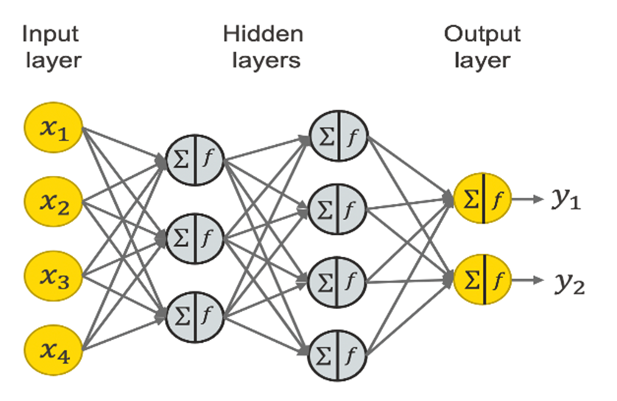
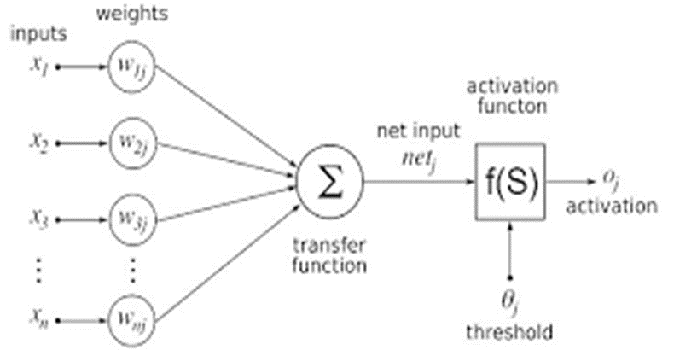

Slide 54
Data Center AI Accelerators
TPUv2
TPUv3
TPUv1
TPUv4i
Eyeriss
SambaNOVA

